Slide 1
CS 2004 Automata Theory

Slide 2
General Info about Course
Instructor: Tapas Kumar Mishra
Books
Introduction to the Theory of Computation, Michael Sipser
An Introduction to Formal Languages and Automata, Peter Linz

Slide 3
Course Goals
Provide computation Models
Analyze power of Models
Answer Intractability questions:
What computational problems
can each model solve?
Answer Time Complexity questions:
How much time we need to
solve the problems?

Slide 4
A widely accepted model of computation
CPU
memory

Slide 5
The different components of memory
temporary memory
input
CPU
output
Program memory

Slide 6



Example:
temporary memory
input
CPU
output
Program memory
compute
compute

Slide 7

temporary memory
input
CPU
output
Program memory
compute
compute

Slide 8


temporary memory
input
CPU
output
Program memory
compute
compute

Slide 9

temporary memory
input
CPU
Program memory
output
compute
compute

Slide 10
Automaton
temporary memory
Automaton
input
CPU
output
Program memory

Slide 11
Automaton
temporary memory
Automaton
input
output
transition
state
CPU+ProgramMem = States + Transitions

Slide 12
Different Kinds of Automata
Automata are distinguished by the temporary memory
  Finite Automata: no temporary memory
  Pushdown Automata: stack
  Turing Machines: random access memory
Costas Busch - LSU

Slide 13
Memory affects computational power:
More flexible memory
results to
The solution of more computational
problems

Slide 14
Finite Automaton
temporary memory
input
Finite Automaton
output
Example: Elevators, Vending Machines,
Lexical Analyzers
(small computing power)

Slide 15
Pushdown Automaton
Temp.
memory
Stack
Push, Pop
input
Pushdown
Automaton
output
Example: Parsers for Programming Languages
(medium computing power)

Slide 16
Turing Machine
Temp.
memory
Random Access Memory
input
Turing
Machine
output
Examples: Any Algorithm
(highest known computing power)

Slide 17
Power of Automata
Simple
problems
More complex
problems
Hardest
problems
Finite
Automata
Pushdown
Automata
Turing
Machine
Less power
More power
Solve more
computational problems

Slide 18
Turing Machine is the most powerful
known computational model
Question: can Turing Machines solve
all computational problems?
Answer: NO
(there are unsolvable problems)

Slide 19
Time Complexity of Computational Problems:
P problems:
(Polynomial time problems)
Solved in polynomial time
NP-complete problems:
(Non-deterministic Polynomial time problems)
Believed to take exponential
time to be solved

Slide 20
Mathematical Preliminaries

Slide 21
Mathematical Preliminaries
Sets
Functions
Relations
Graphs
Proof Techniques

Slide 22
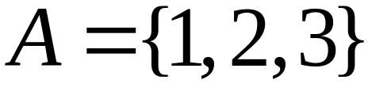

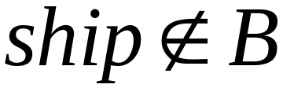
SETS
A set is a collection of elements
We write

Slide 23
Set Representations
  C = { a, b, c, d, e, f, g, h, i, j, k }
  C = { a, b, …, k }
  S = { 2, 4, 6, … }
  S = { j : j > 0, and j = 2k for some k>0 }
  S = { j : j is nonnegative and even }
finite set
infinite set

Slide 24
A = { 1, 2, 3, 4, 5 }
U
6
A
2
8
1
3
7
4
5
9
10
Universal Set: all possible elements
    U = { 1 , … , 10 }

Slide 25
Set Operations
A = { 1, 2, 3 } B = { 2, 3, 4, 5}
Union
A U B = { 1, 2, 3, 4, 5 }
Intersection
    A B = { 2, 3 }
Difference
    A - B = { 1 }
    B - A = { 4, 5 }
A
B
2
4
1
3
5
U
2
3
1
Venn diagrams

Slide 26
Complement
      Universal set = {1, …, 7}
      A = { 1, 2, 3 } A = { 4, 5, 6, 7}
4
A
A
6
1
3
2
5
7
A = A

Slide 27
{ even integers } = { odd integers }
Integers
1
odd
0
5
even
2
6
4
3
7

Slide 28
DeMorgan’s Laws
A U B = A B
U
A B = A U B
U

Slide 29
Empty, Null Set:
= { }
S U = S
S =
S - = S
- S =
U
= Universal Set

Slide 30
Subset
A = { 1, 2, 3} B = { 1, 2, 3, 4, 5 }
U
A B
Proper Subset:
U
A B
B
A

Slide 31
Disjoint Sets
A = { 1, 2, 3 } B = { 5, 6}
A B =
U
A
B

Slide 32
Set Cardinality
For finite sets
A = { 2, 5, 7 }
|A| = 3
(set size)

Slide 33
Powersets
A powerset is a set of sets
S = { a, b, c }
Powerset of S = the set of all the subsets of S
2^{S} = { , {a}, {b}, {c}, {a, b}, {a, c}, {b, c}, {a, b, c} }
Observation: | 2^{S} | = 2^{|S|} ( 8 = 2³ )

Slide 34
Cartesian Product
A = { 2, 4 } B = { 2, 3, 5 }
A X B = { (2, 2), (2, 3), (2, 5), ( 4, 2), (4, 3), (4, 5) }
|A X B| = |A| |B|
Generalizes to more than two sets
A X B X … X Z

Slide 35
FUNCTIONS
domain
range
4
A
B
f(1) = a
1
a
2
b
3
c
5
f : A -> B
If A = domain
then f is a total function
otherwise f is a partial function

Slide 36
RELATIONS
R = {(x₁, y₁), (x₂, y₂), (x₃, y₃), …}
x_{i} R y_{i}
e. g. if R = ‘>’: 2 > 1, 3 > 2, 3 > 1

Slide 37
Equivalence Relations
Reflexive: x R x
Symmetric: x R y y R x
Transitive: x R y and y R z x R z
Example: R = ‘=‘
x = x
x = y y = x
x = y and y = z x = z

Slide 38
Equivalence Classes
For equivalence relation R
equivalence class of x = {y : x R y}
Example:
R = { (1, 1), (2, 2), (1, 2), (2, 1),
(3, 3), (4, 4), (3, 4), (4, 3) }
Equivalence class of 1 = {1, 2}
Equivalence class of 3 = {3, 4}

Slide 39
GRAPHS
A directed graph
e
b
node
a
d
edge
c
Nodes (Vertices)
V = { a, b, c, d, e }
Edges
E = { (a,b), (b,c), (b,e),(c,a), (c,e), (d,c), (e,b), (e,d) }

Slide 40
Labeled Graph
2
6
e
2
b
1
3
a
d
6
5
c

Slide 41
Walk
e
b
a
d
c
Walk is a sequence of adjacent edges
(e, d), (d, c), (c, a)

Slide 42
Path
e
b
a
d
c
Path is a walk where no edge is repeated
Simple path: no node is repeated

Slide 43
Cycle
e
base
b
3
1
d
a
2
c
Cycle: a walk from a node (base) to itself
Simple cycle: only the base node is repeated

Slide 44
Euler Tour
8
base
7
e
b
1
4
6
5
d
a
2
3
c
A cycle that contains each edge once

Slide 45
Hamiltonian Cycle
5
base
e
b
1
4
a
2
d
3
c
A simple cycle that contains all nodes

Slide 46
Trees
root
parent
leaf
child
Trees have no cycles

Slide 47
root
Level 0
Level 1
leaf
Height 3
Level 2
Level 3

Slide 48
Binary Trees

Slide 49
PROOF TECHNIQUES
Proof by induction
Proof by contradiction

Slide 50
Induction
We have statements P₁, P₂, P₃, …
If we know
    for some b that P₁, P₂, …, P_{b} are true
    for any k >= b that
        P₁, P₂, …, P_{k} imply P_{k+1}
Then
Every P_{i} is true

Slide 51
Proof by Induction
Inductive basis
    Find P₁, P₂, …, P_{b} which are true
Inductive hypothesis
    Let’s assume P₁, P₂, …, P_{k} are true,
    for any k >= b
Inductive step
    Show that P_{k+1} is true

Slide 52
Example
Theorem: A binary tree of height n
has at most 2^{n} leaves.
Proof by induction:
let L(i) be the maximum number of
leaves of any subtree at height i

Slide 53
We want to show: L(i) <= 2^{i}
Inductive basis
      L(0) = 1 (the root node)
Inductive hypothesis
      Let’s assume L(i) <= 2^{i} for all i = 0, 1, …, k
Induction step
      we need to show that L(k + 1) <= 2^{k+1}

Slide 54
Induction Step
height
k
k+1
From Inductive hypothesis: L(k) <= 2^{k}

Slide 55
Induction Step
height
L(k) <= 2^{k}
k
k+1
L(k+1) <= 2 * L(k) <= 2 * 2^{k} = 2^{k+1}
(we add at most two nodes for every leaf of level k)

Slide 56
Remark
Recursion is another thing
Example of recursive function:
    f(n) = f(n-1) + f(n-2)
    f(0) = 1, f(1) = 1

Slide 57
Proof by Contradiction
We want to prove that a statement P is true
    we assume that P is false
    then we arrive at an incorrect conclusion
    therefore, statement P must be true

Slide 58
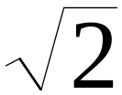
Example
Theorem: is not rational
Proof:
    Assume by contradiction that it is rational
    = n/m
    n and m have no common factors
    We will show that this is impossible

Slide 59
= n/m 2 m² = n²
n is even
n = 2 k
Therefore, n² is even
m is even
m = 2 p
2 m² = 4k²
m² = 2k²
Thus, m and n have common factor 2
Contradiction!

Slide 60
Languages

Slide 61
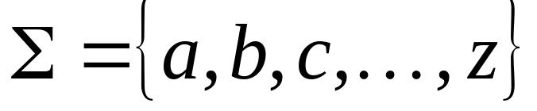
Language: a set of strings
String: a sequence of symbols
from some alphabet
Example:
Strings: cat, dog, house
Language: {cat, dog, house}
Alphabet:

Slide 62
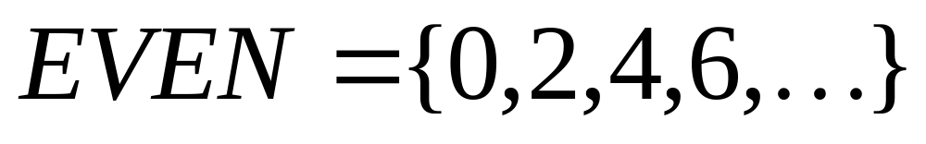
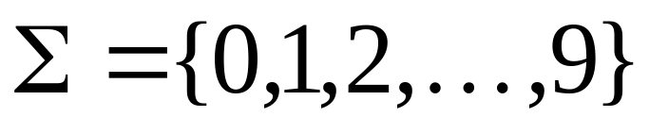
Languages are used to describe
computation problems:
Alphabet:

Slide 63

Computation is translated to set membership
Example computation problem:
Is number prime?
Equivalent set membership problem:

Slide 64

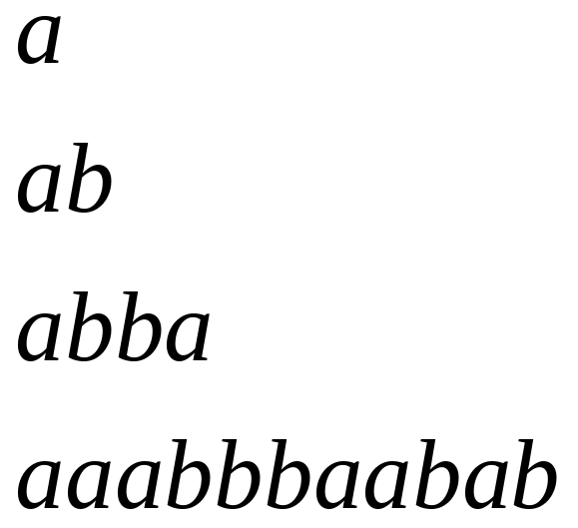
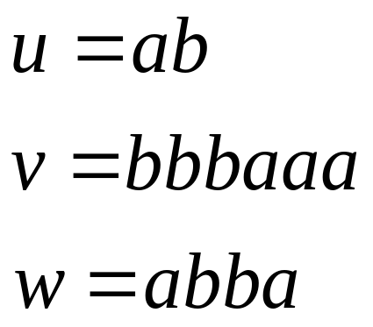
Alphabets and Strings
An alphabet is a set of symbols
Example Alphabet:
A string is a sequence of
symbols from the alphabet
String variables
Example Strings

Slide 65
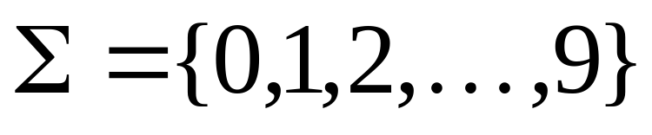
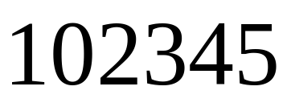
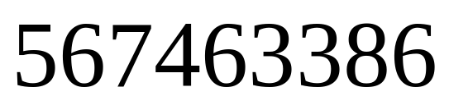
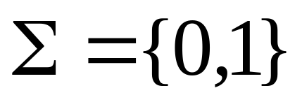
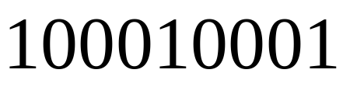
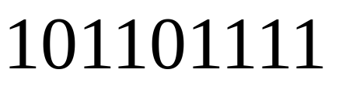
Decimal numbers alphabet
Binary numbers alphabet

Slide 66
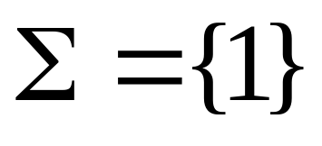

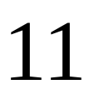
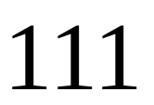
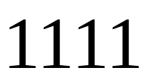





Unary numbers alphabet
Unary number:
Decimal number:

Slide 67
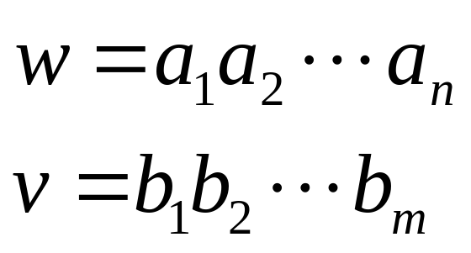
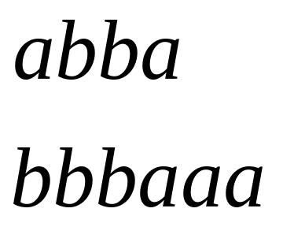
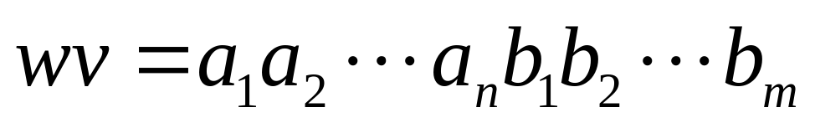
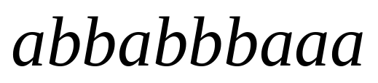
String Operations
Concatenation

Slide 68




Reverse

Slide 69


String Length
Length:
Examples:

Slide 70
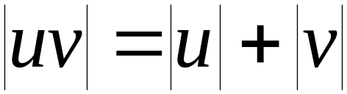

Length of Concatenation
Example:

Slide 71
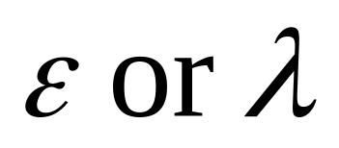
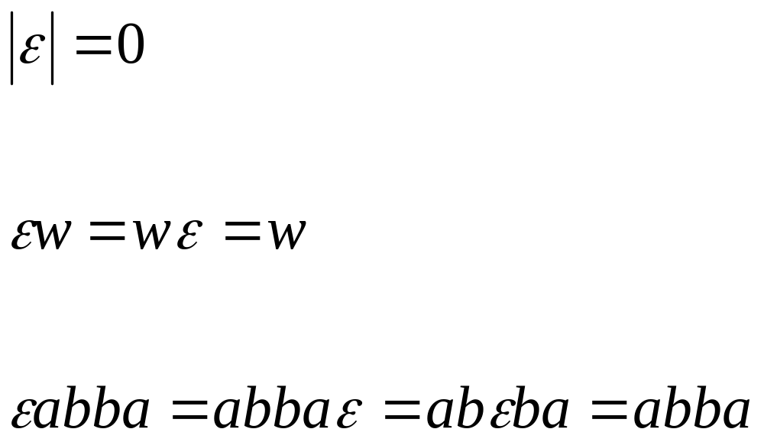
Empty String
A string with no letters is denoted:
Acts as a neutral element
Observations:

Slide 72


Substring
Substring of string:
  a subsequence of consecutive characters
String Substring

Slide 73

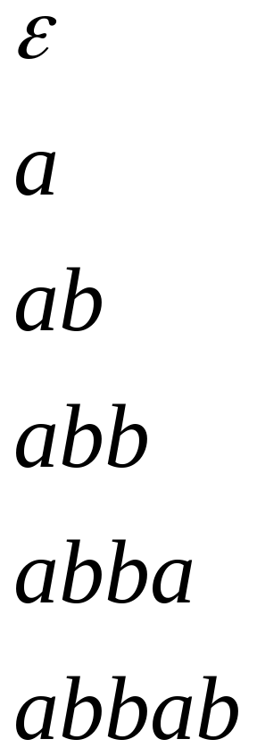
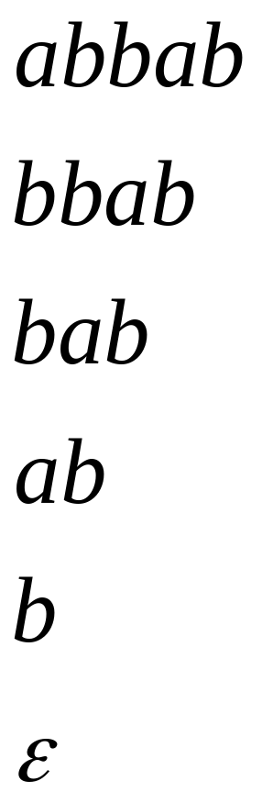

Prefix and Suffix
Prefixes Suffixes
string
prefix
suffix

Slide 74
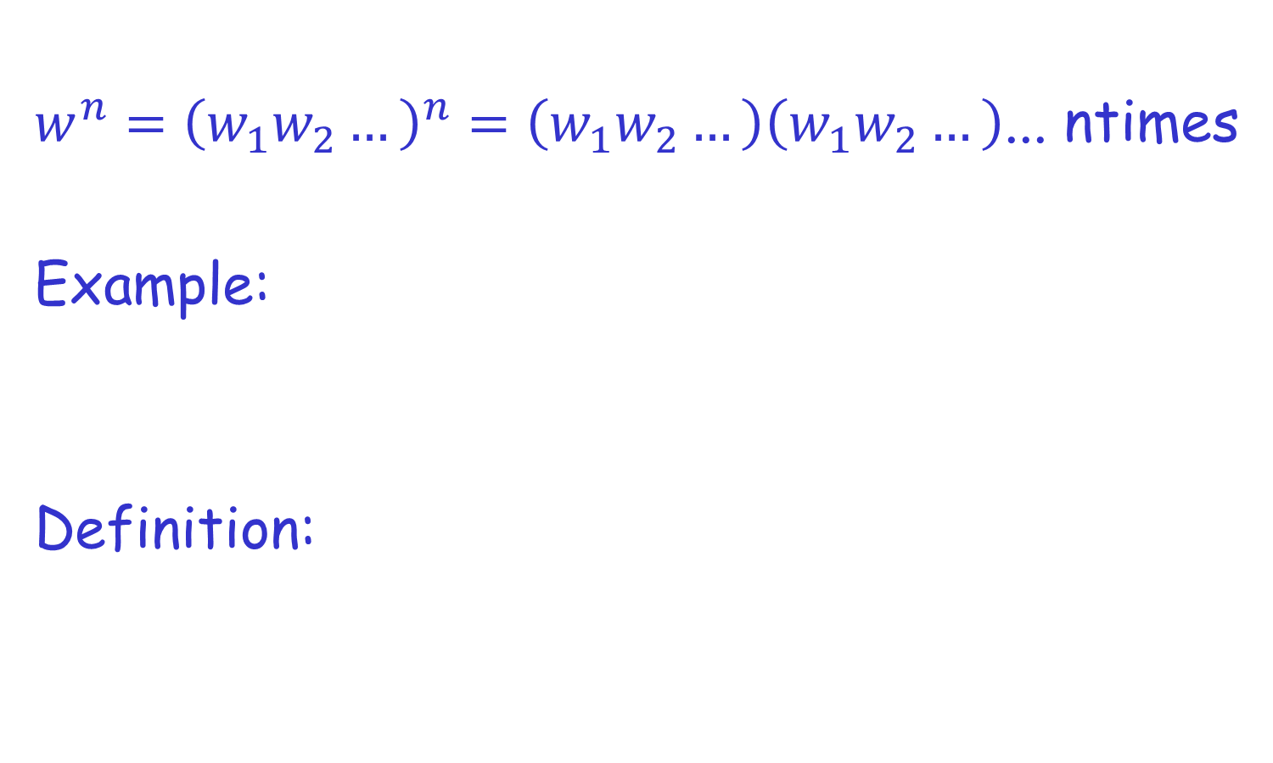

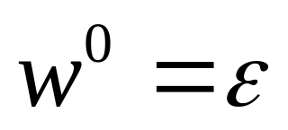
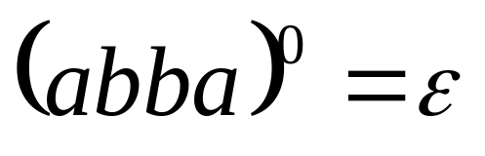
Exponent Operation

Slide 75


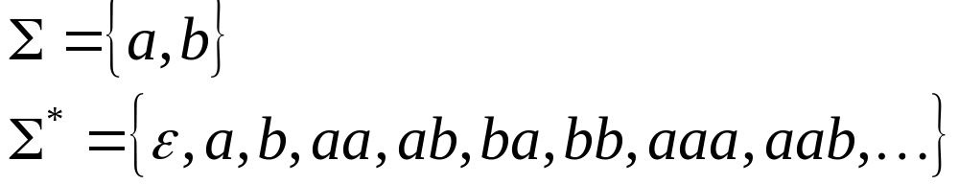
The * Operation
: the set of all possible strings from
alphabet

Slide 76


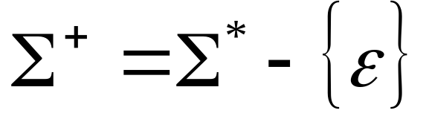
The + Operation
: the set of all possible strings from
alphabet except

Slide 77

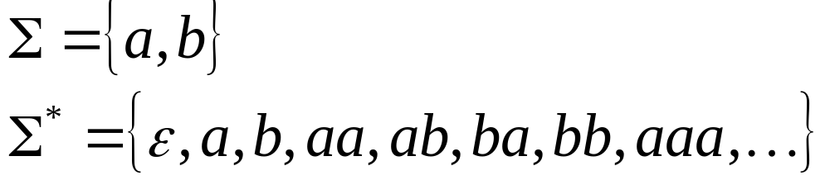
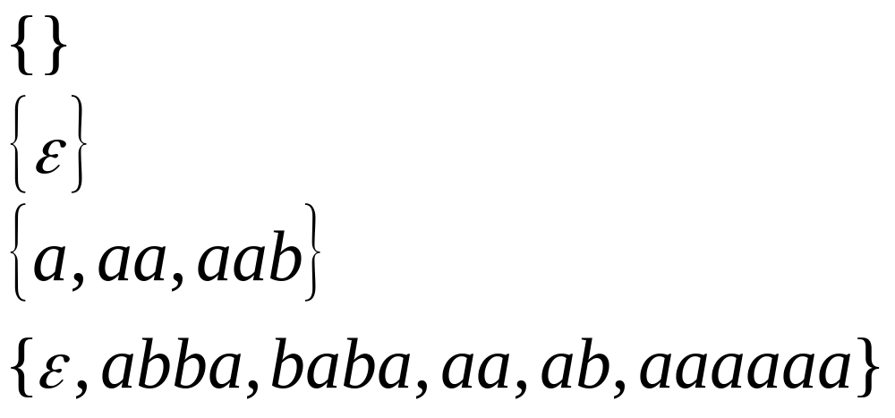
Languages
A language over alphabet
is any subset of
Example:
Languages:

Slide 78
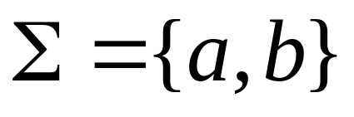
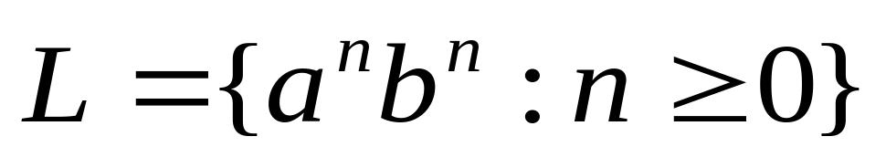
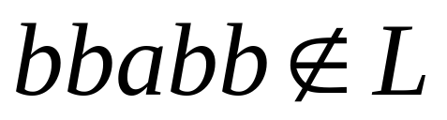
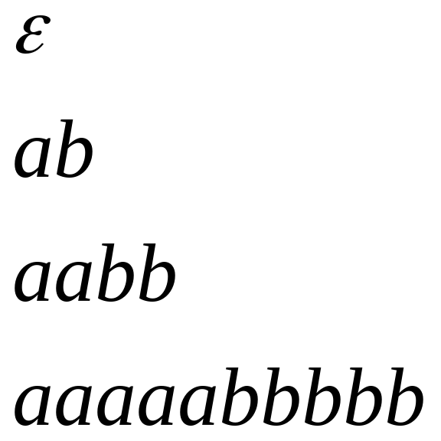
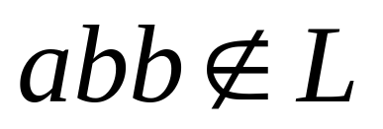

More Language Examples
An infinite language
Alphabet

Slide 79
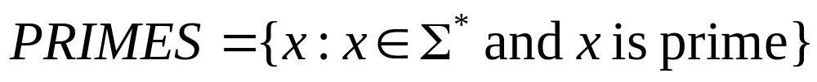
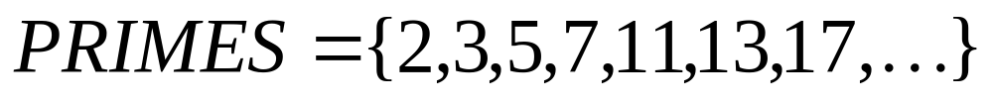
Prime numbers
Numbers divisible by 1 and itself
Alphabet
Language:

Slide 80

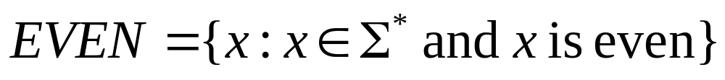
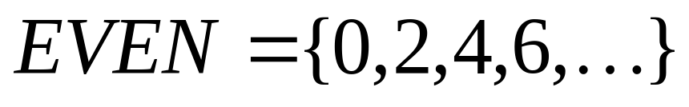
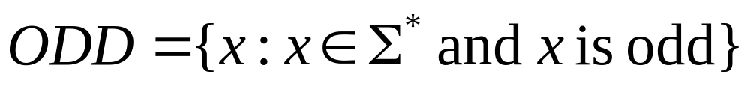
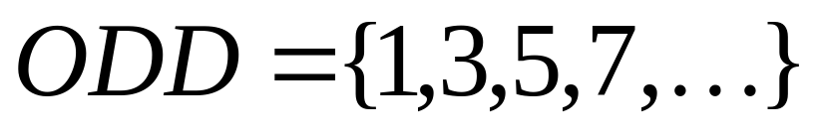
Even and odd numbers
Alphabet
Languages:

Slide 81
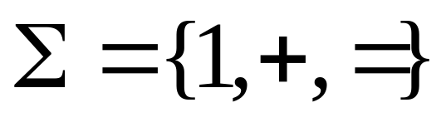
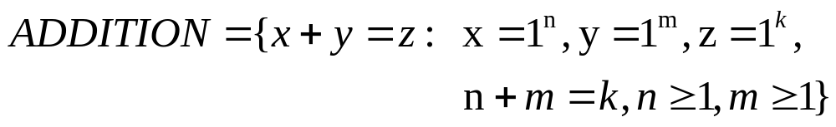
Addition (of unary numbers)
Alphabet:
Language:

Slide 82
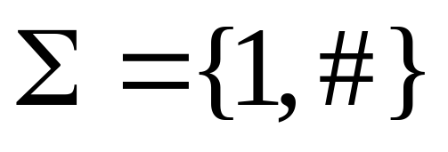
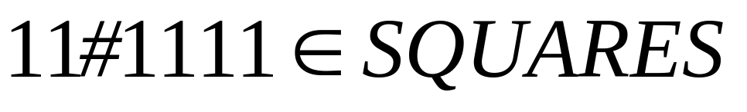
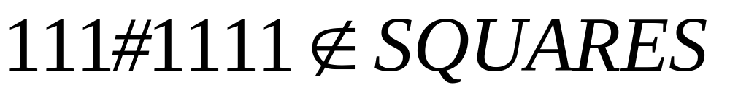
Squares (of unary numbers)
Alphabet:
Language:

Slide 83



Two special languages
Language with
empty string
Empty language
Size of a language (number of elements):

Slide 84




Note that:
Sets
Set size
Set size
String length

Slide 85



Operations on Languages
The usual set operations:
Complement:

Slide 86



Reverse
Definition:
Examples:

Slide 87


Concatenation
Definition:
Example:

Slide 88



Another Operation

Slide 89



Example

Slide 90







Star-Closure (Kleene *)
All strings that can be constructed from
Definition:
Example:

Slide 91



Positive Closure
Definition:
Note that:

